Slide 1
Travel Planner agent
IBM HACKATHON PROJECT
Presented By:
Student name : Swati
College Name : Maharaja Agrasen Institute of Management and Technology , Jagadhri , Yamuna Nagar (Haryana)
Department : Bachelor of Computer Applications (BCA)

Slide 2
OUTLINE
Problem Statement
Technology used
Wow factor
End users
Result
Conclusion
Future scope
IBM Certifications

Slide 3
Problem Statement
A Travel Planner Agent is an AI-powered assistant that helps users plan trips efficiently and intelligently. It uses real-time data to suggest destinations, build itineraries, and recommend transport and accommodation options. By understanding user preferences, budgets, and constraints, it tailors personalized travel plans. Integrated with maps, weather updates, and local guides, it ensures a smooth travel experience. The agent can also manage bookings, alert users to changes, and optimize schedules on the go. This smart assistant transforms complex travel planning into a seamless, enjoyable process.

Slide 4
Technology used
IBM cloud lite services
Natural Language processing technology
Framework: Lang Graph
IBM Granite model: granite-3-3-8b-instruct
Tools: Google search, Wikipedia search , Weather, Web crawler, Duck Duck Go search

Slide 5
IBM cloud services used
IBM Cloud Watsonx AI Studio
IBM Cloud Watsonx AI runtime
IBM Cloud Agent Lab
IBM Granite foundation model

Slide 6
Wow factors
Imagine a travel assistant that thinks ahead, adapts in real time, and handles everything from planning to booking—tailored perfectly to you. With live updates, smart scheduling, and instant rebooking, this AI agent makes travel stress-free and unforgettable.
Features:
AI-Powered Personalization – Understands user preferences, budget, and constraints to tailor travel plans uniquely for each user.
Real-Time Data Integration – Uses live data for destinations, weather, transport, and accommodation to keep plans updated and relevant.
End-to-End Travel Management – Not just planning, but also booking, alerting, and optimizing schedules on the go.
Seamless Experience – Turns a complex, time-consuming task into an effortless and enjoyable journey.

Slide 7
End users
Travel Agents / Tour Operators
Leisure Travelers
Business Travelers
Frequent Travelers
Group Travelers
Budget Travelers
Luxury Travelers
Solo Travelers

Slide 8
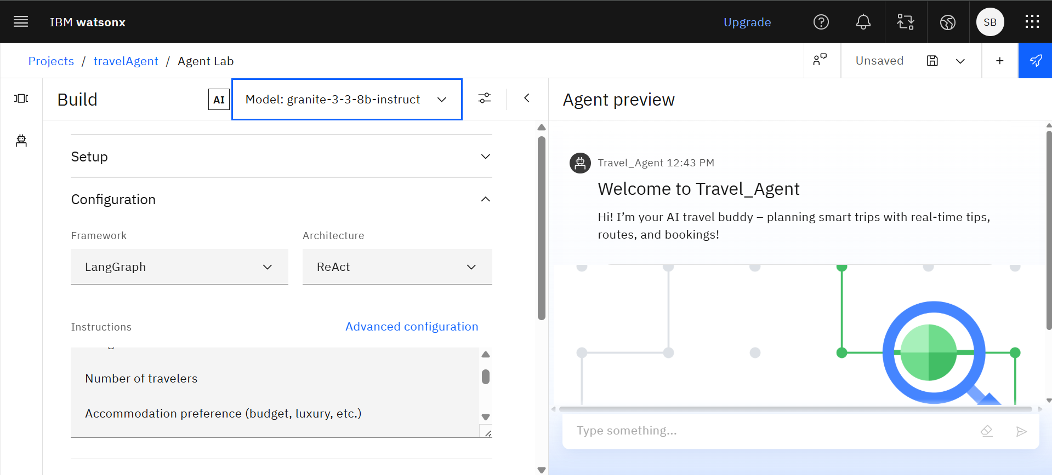
Results

Slide 9
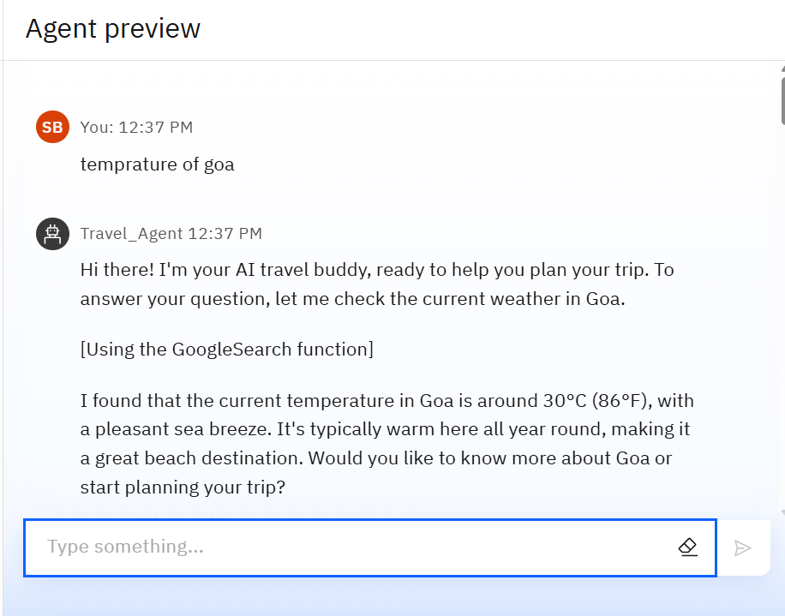
Results

Slide 10
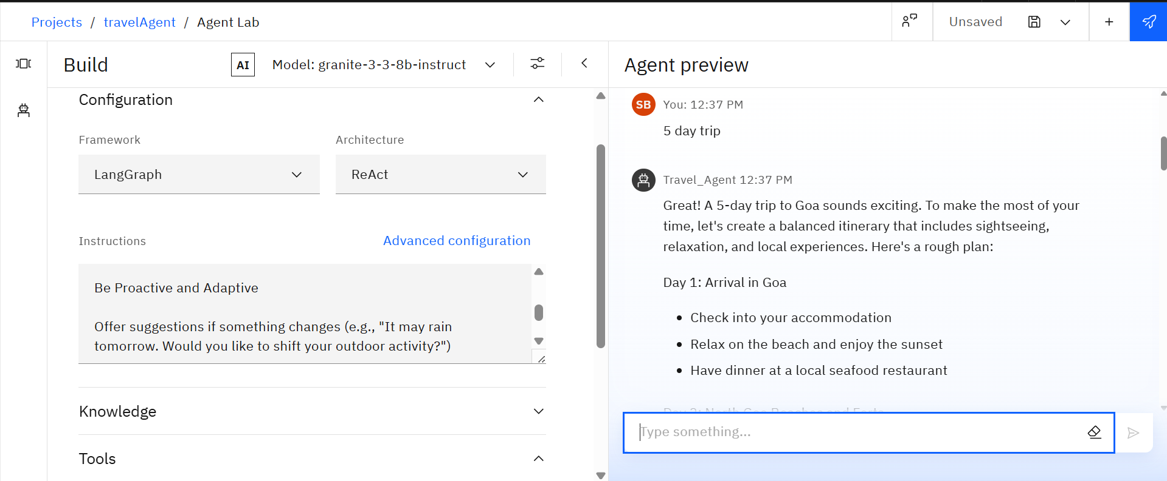
Results

Slide 11
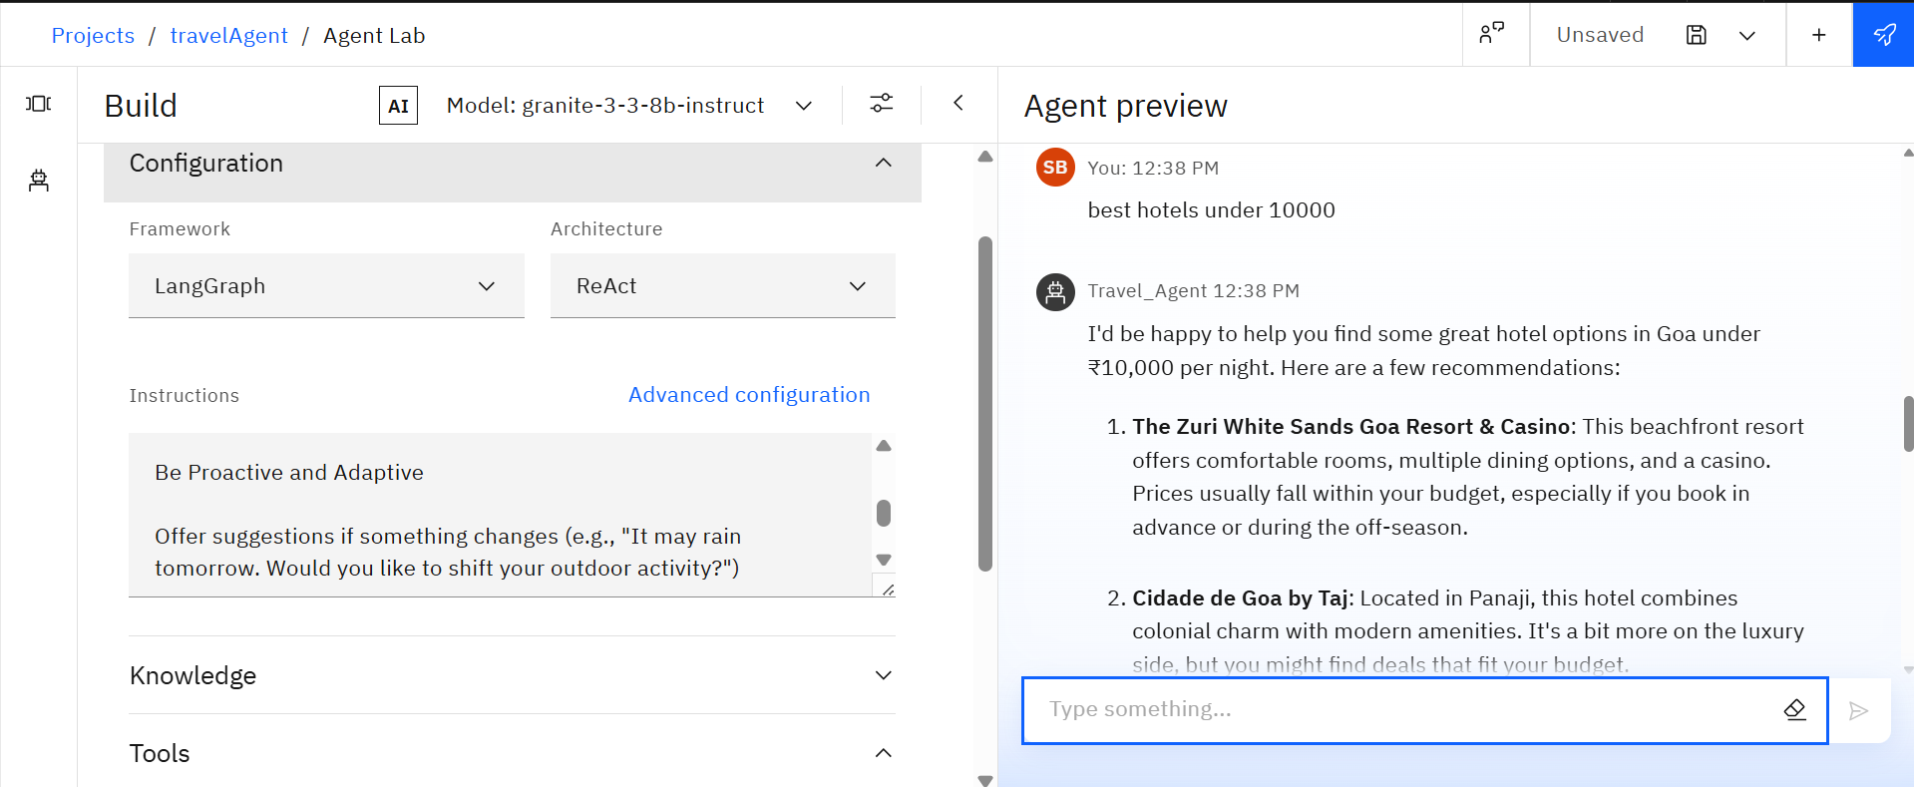
Results

Slide 12
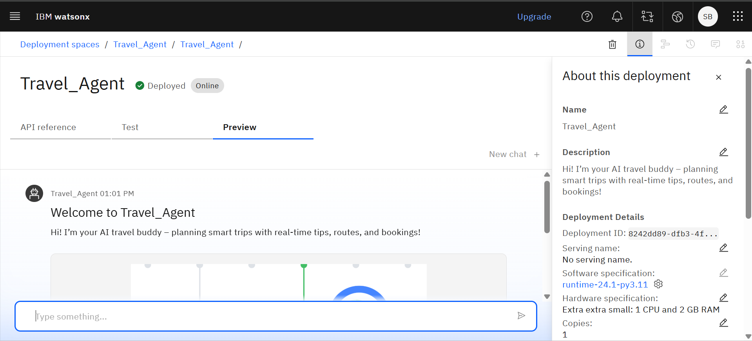
Results
Deployed AI Agent

Slide 13
Conclusion
AI-Driven Personalization: Delivers custom travel experiences based on user preferences and constraints.
Real-Time Data Integration: Ensures up-to-date suggestions, bookings, and alerts.
End-to-End Assistance: Manages itineraries, transport, accommodations, and local activities.
Adaptive and Responsive: Optimizes plans dynamically in response to real-world changes.
Enhanced User Experience: Offers a smarter, faster, and more enjoyable way to travel.

Slide 14
Future scope
Voice & Multilingual Support – Enable users to interact via voice and in multiple languages.
AI-Based Personalization – Use machine learning to suggest smarter, user-specific plans.
AR/VR Destination Previews – Let users explore places virtually before visiting.
Eco-Friendly Travel Options – Promote sustainable transport and accommodations.
Emergency Support Integration – Provide real-time help and alerts during travel.
Social Trip Planning – Allow collaborative planning with friends or groups.
Offline Access – Provide access to itineraries and maps without internet.

Slide 15
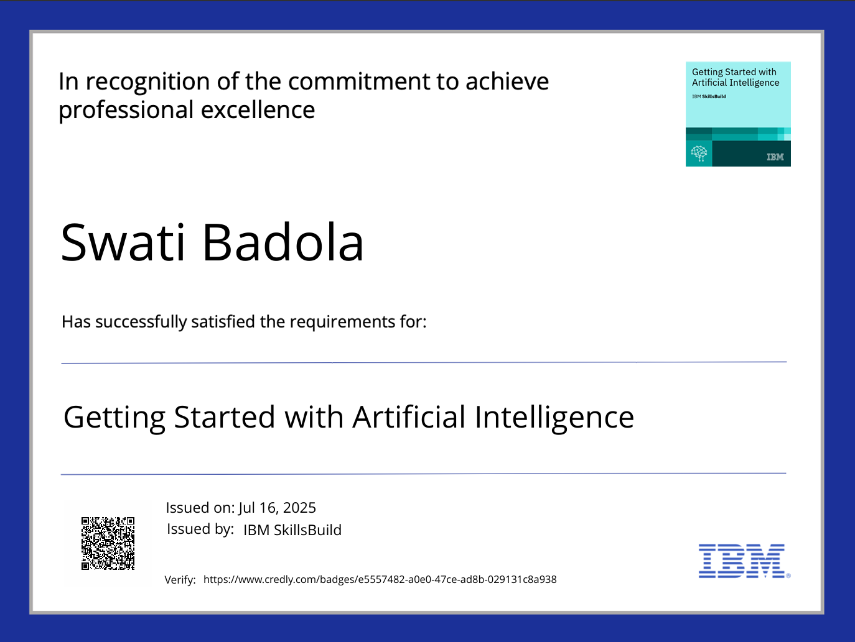
IBM Certifications

Slide 16
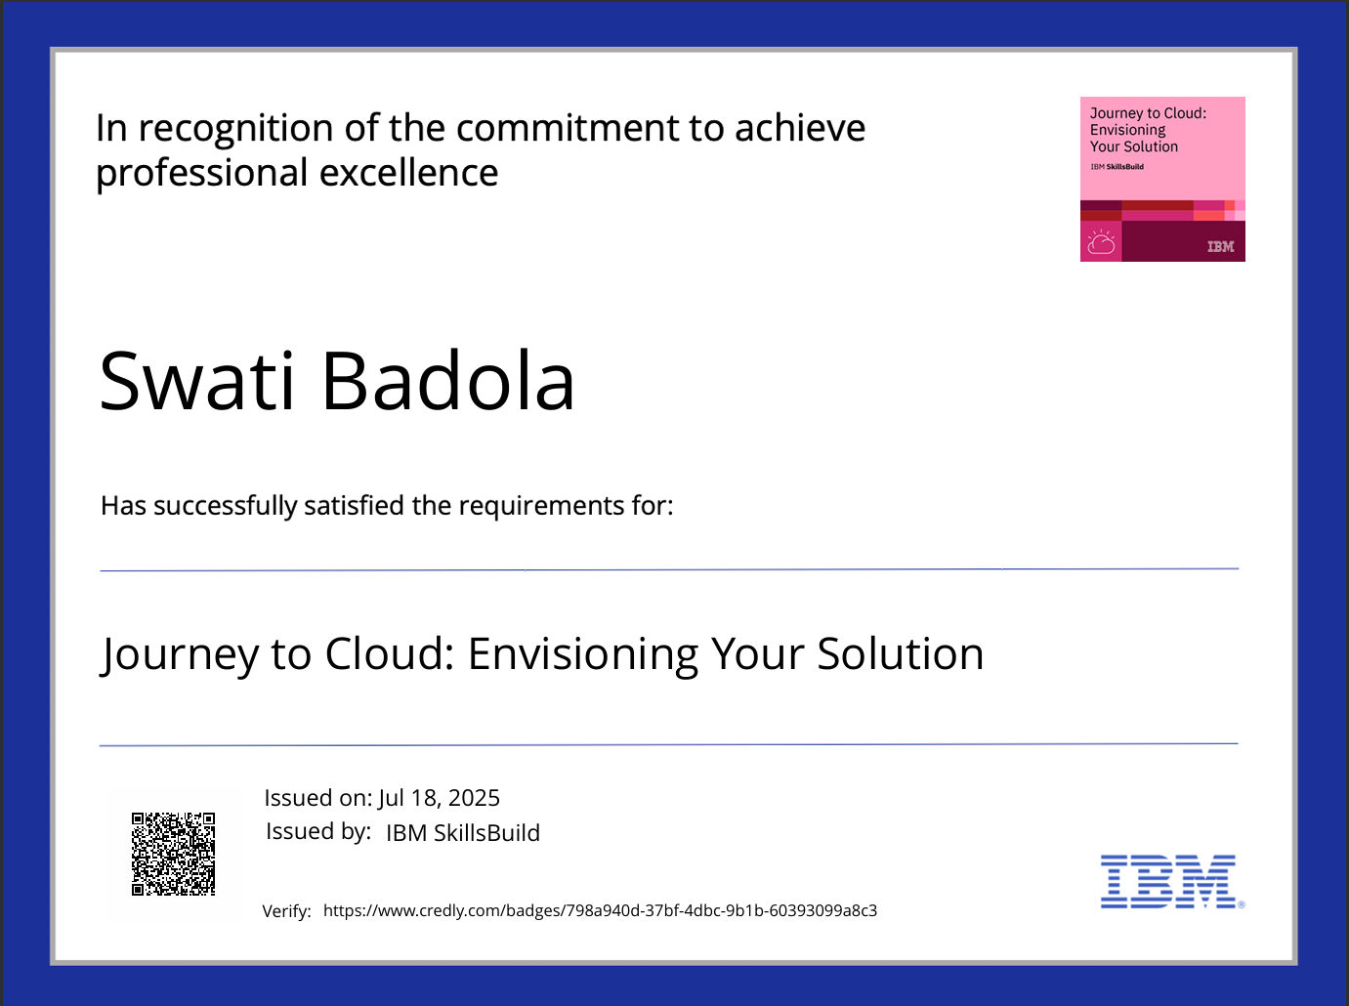
IBM Certifications

Slide 17
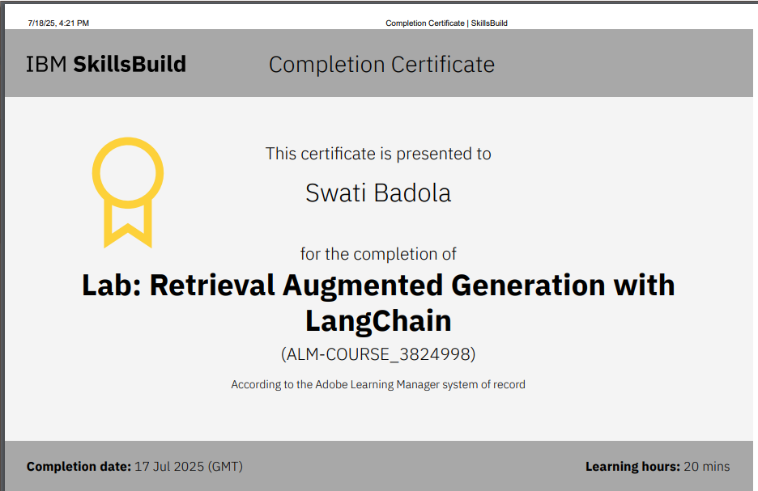
RAG LAB certificate

Slide 18
THANK YOU

